Slide 1



GOVERNMENT COLLEGE OF ENGINEERING, SALEM-11 (An Autonomous Institution Affiliated to Anna University, Chennai)
DEPARTMENT OF COMPUTER SCIENCE AND ENGINEERING
18CS605 - MINI PROJECT
AskDu: Empowering Students with AI-Driven Career Navigation and College Counselling Assistance
TEAM MEMBERS
Masaniyammal N - 61772121025
Megha harthana S - 61772121026
Sivaranjani C K - 61772121042
PROJECT GUIDE
Dr.P.Tharani M.E., Ph.D.,
Assistant Professor / CSE,
(Government College Of Engineering, salem-11)

Slide 2
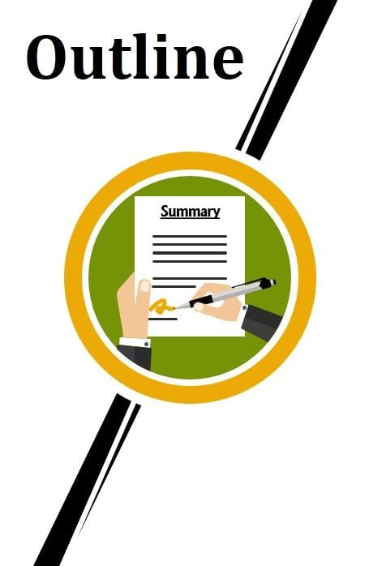
OUTLINE OF PRESENTATION
Problem Statement
Motivation
Objective
Literature survey
Proposed System
Architecture
Hardware & Software Requirements
List of Modules
Algorithm / Technique Used
Conclusion
Future Work
References

Slide 3

PROBLEM STATEMENT
Design and develop a career guidance chatbot, utilizing AI and natural language processing (NLP), Tailored to provide personalized advice and support, Accessible across various platforms for seamless user interaction.

Slide 4

MOTIVATION OF THE PROJECT
The motivation behind our idea is that:
After completing our 12th grade, students lost themselves in the sea of options.
The availability of various career paths can often lead students to become confused when choosing the right path.
Every student's career path is unique.
Many students may lack access to personalized career guidance due to limited resources or support services.
Spent hours through various resources, only to get fragmented information scattered across different platforms.
With a growing number of students seeking career guidance, scalability becomes a crucial factor.
So, Decided to build a centralized platform to fill the gap and offering clear guidance.

Slide 5

OBJECTIVE
Developing an user-friendly chat bot interface that provides advice based on individual student profiles.
Ensure easy access to relevant information about college admissions, competitive exams, and other career paths.
Make the college counseling process more transparent and manageable for students.

Slide 6
LITERATURE SURVEY
Year | Author Name | Title | Algorithm / Technique Used | Description | Advantage & Disadvantage
2018 | Aldridge et al. | BeeBee Blackboard Chat-Bot | AI-based chatbot Natural Language Processing | This provide students, faculty, and staff with the information they require, promptly and through their preferred means of interaction with a self-service chatbot. | Show higher education opportunities and better UI experience. Complexity of user queries, Depend on internet connectivity and infrastructure availability

Slide 7
Year | Author Name | Title | Algorithm / Technique Used | Description | Advantage & Disadvantage
2020 | Sofie Roos et al. | Chatbots in Education | Visual Dialog | This requires an AI agent to hold a significant dialog with humans in natural, conversational language about visual content. | A general test of machine intelligence. Objective analysis of response Development and maintenance of a large Visual Dialog dataset are costly.

Slide 8




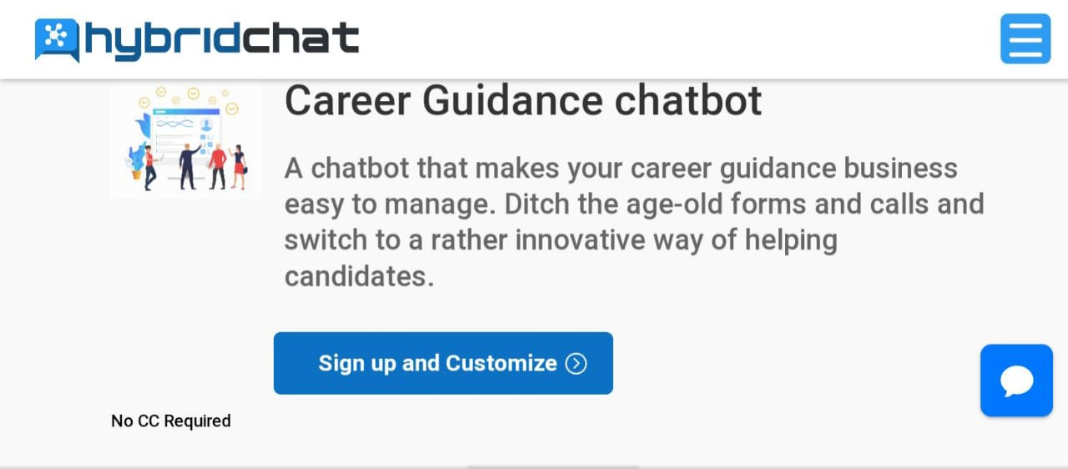
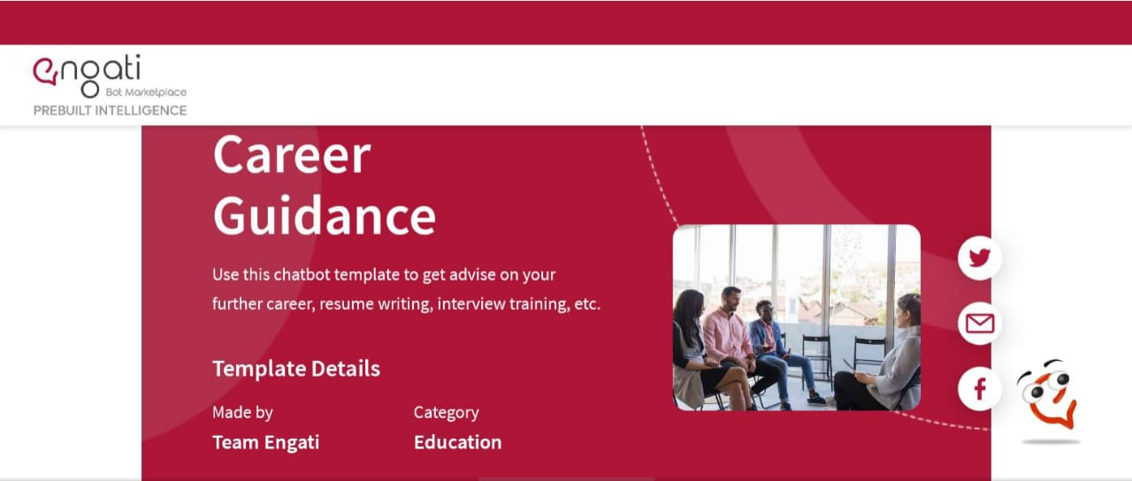




SUMMARY OF EXISTING SYSTEM:
In-person counseling or workshops, can be time-consuming and resource-intensive for both students.
Students encounter challenges in accessing information about colleges and competitive exams due to scattered online resources.
The lack of a centralized platform leads to inefficiencies in their career planning.
It doesn’t have any personalization for each student’s requirement.
These are not always easy to access, which can make students feel stressed and unsure about their future.
And it doesn’t provide any report about individual student.

Slide 9










PROPOSED SYSTEM
Our chatbot can offer personalized recommendations in the form of categories and applying filters and support multiple users based on individual interests, skills, and goals.
It offers immediate responses to student inquiries and time-saving.
It provides a convenient and accessible platform for students to seek guidance anytime, anywhere, without barriers like geographical location or office hours.
By Integrating career guidance into a familiar and interactive format like a chatbot, makes students to actively participate in their career development journey.
It provide in-build Cutoff calculator and analysis report of chat with list of colleges and also store the history of chats.
It also provide remainder notification about competitive exam and counselling to the students.

Slide 10
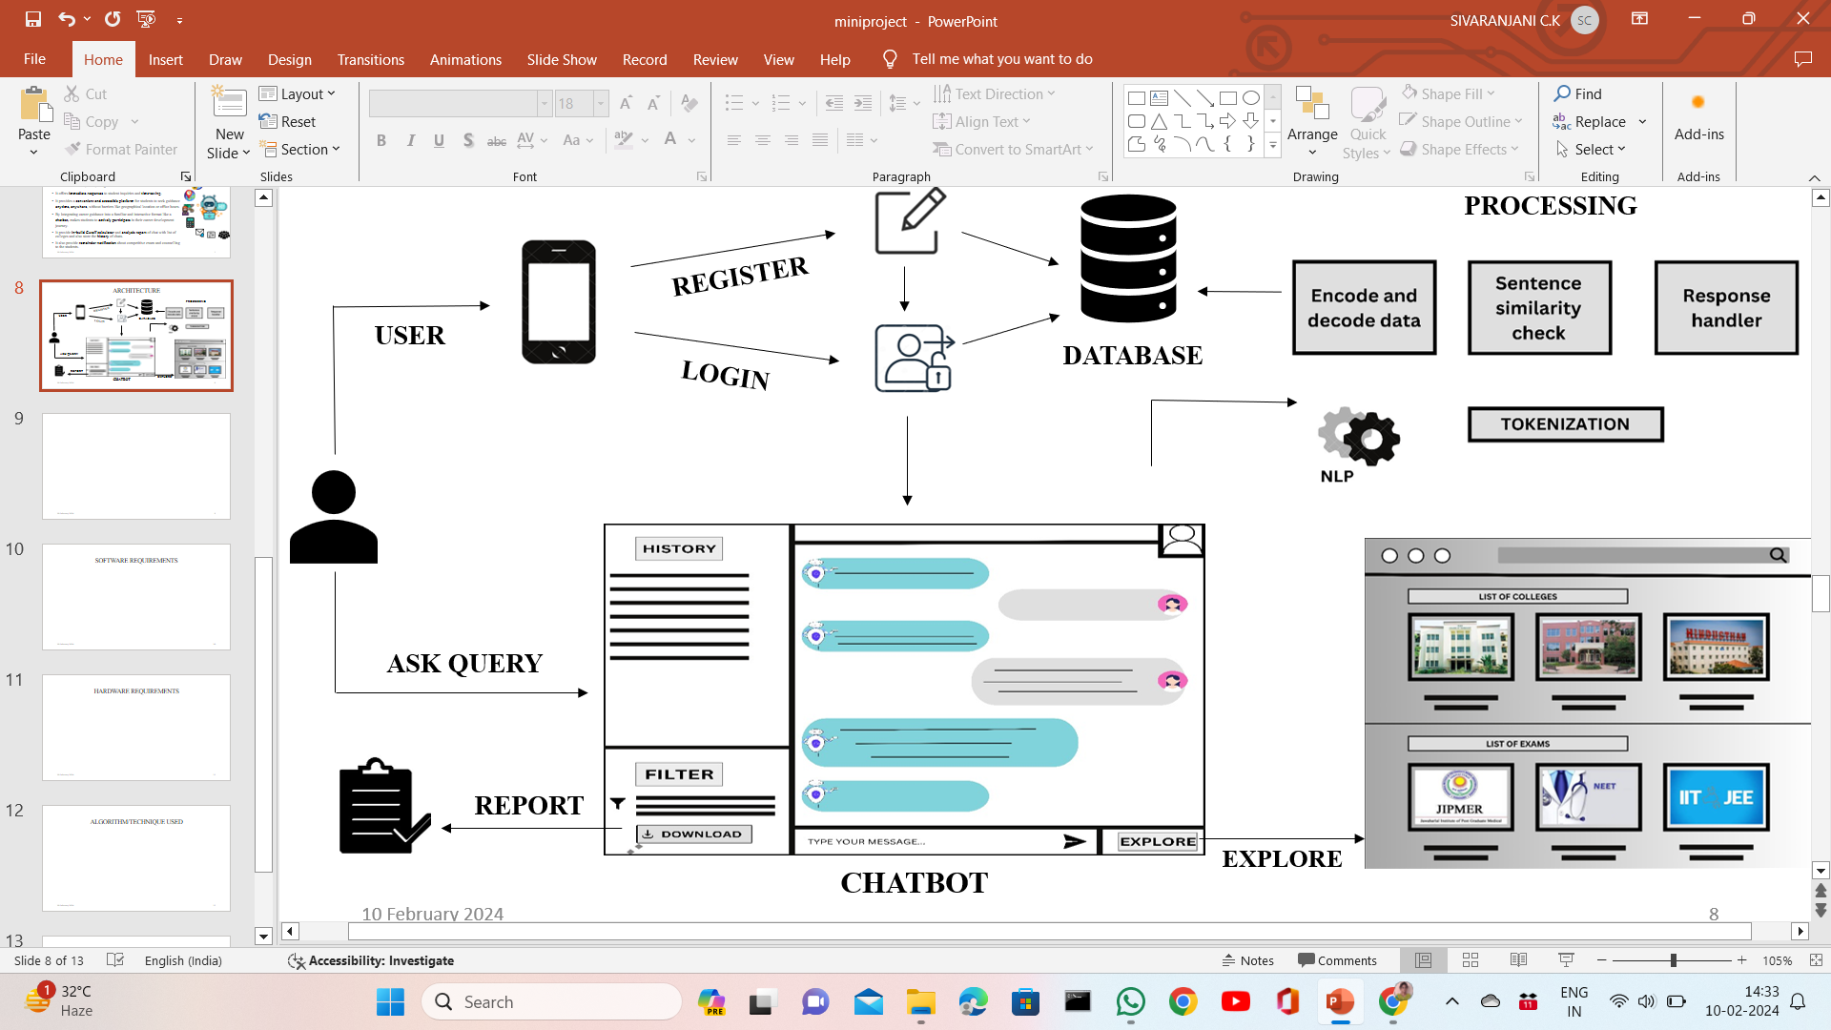
ARCHITECTURE

Slide 11




SOFTWARE REQUIREMENTS
OPERATING SYSTEM
OS: Windows 11 Home
OS Architecture: 64 Bit
System Architecture: 64
INTEGRATED DEVELOPMENT ENVIRONMENT ( IDE )
Visual Studio Code(Vs Code)
Jupyter Notebook and Google Collab
CODE MAINTANENCE
Git and GitHub
FRAMEWORK
Flask
DATABASE
MongoDB

Slide 12

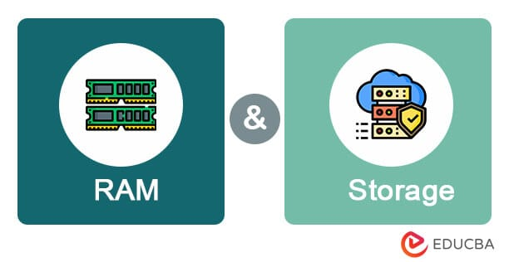

HARDWARE REQUIREMENTS
PROCESSOR
Brand: AMD
Name: Ryzen 5 Hexa Core
Variant: 4500U
Graphic Processor: AMD Radeon Vega 8
Number of Cores: 6
RAM
Capacity: 8 GB
Type: DDR4
Frequency: 2666 MHz
STORAGE
Capacity: 256 GB
INTERNET CONNECTION

Slide 13





LIST OF MODULES
SIGNUP AND LOGIN
MODEL TRAINING AND CHATBOT INTERFACE
CUTOFF CALCULATOR
REPORT DOWNLOAD
EXPLORE

Slide 14
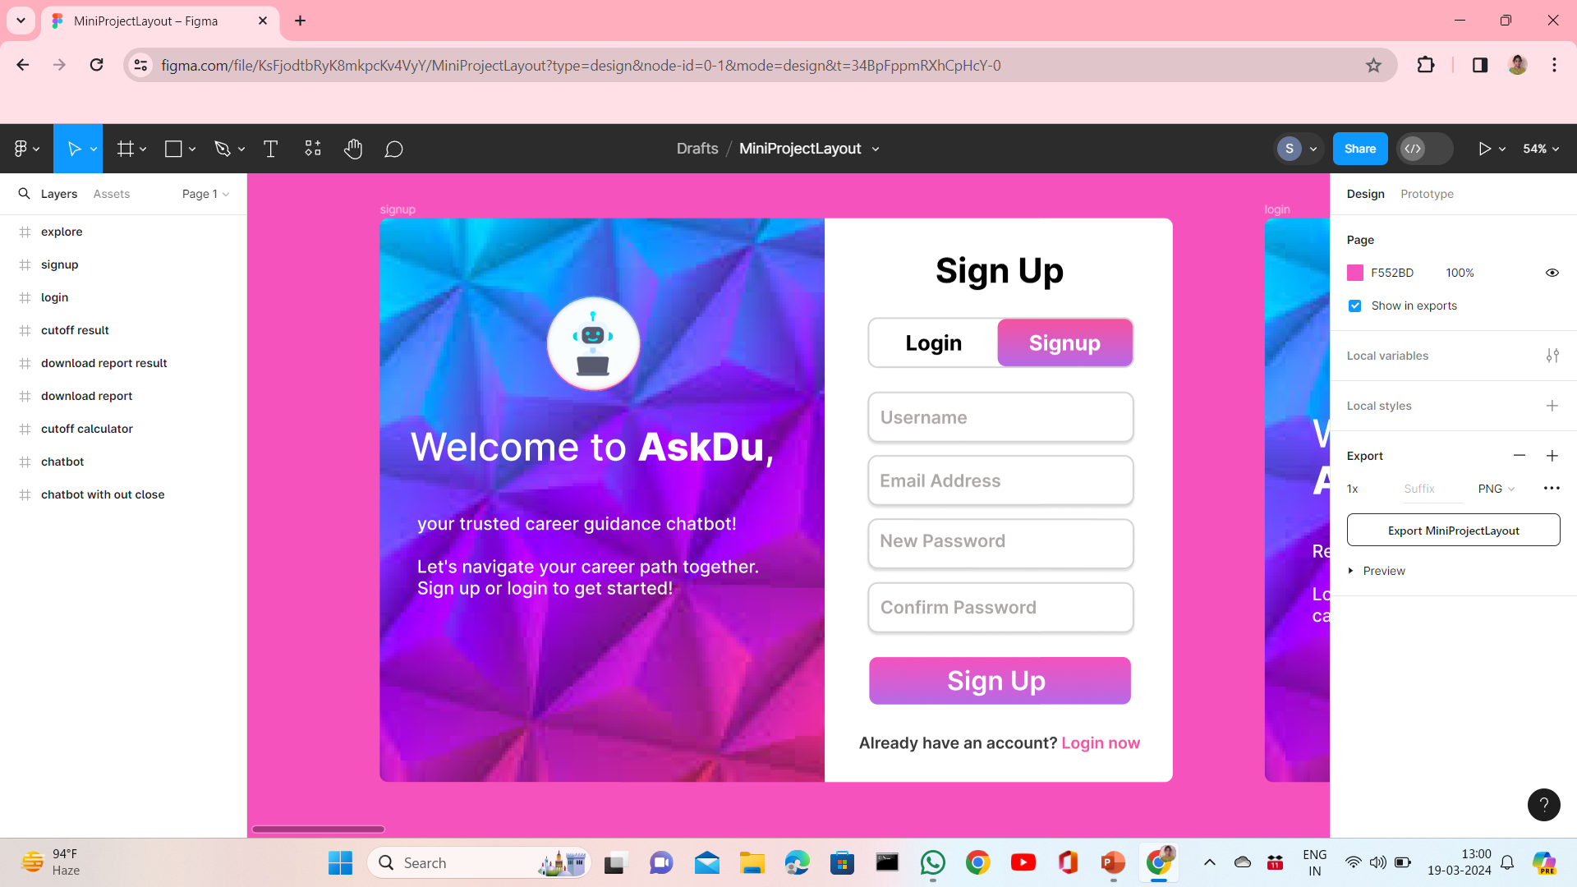
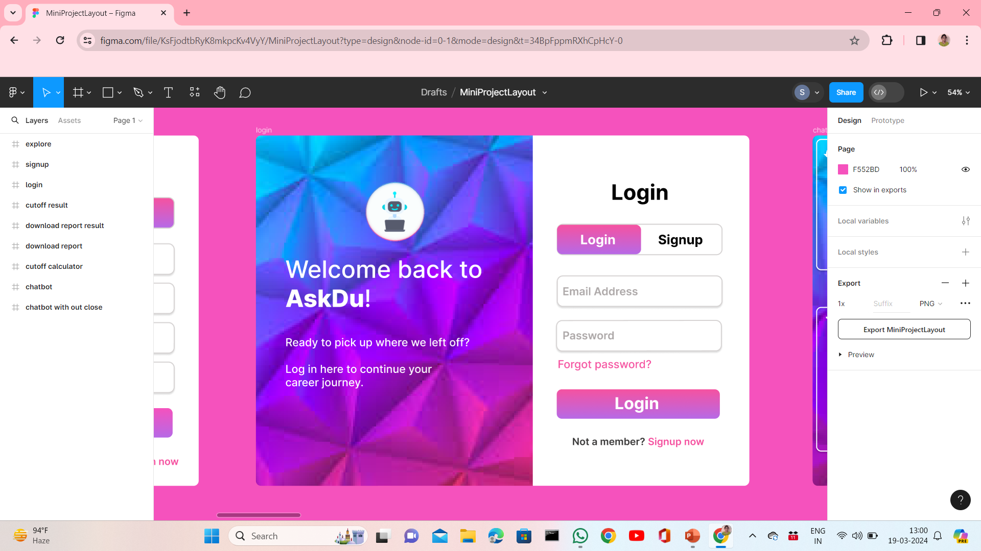
1. SIGNUP AND LOGIN MODULE
This module handles user authentication and authorization processes.
Features include user signup, login, logout, password reset, and account management functionalities.
It ensures secure access to the system by authenticating users based on their credentials.
SIGNUP PAGE
LOGIN PAGE

Slide 15
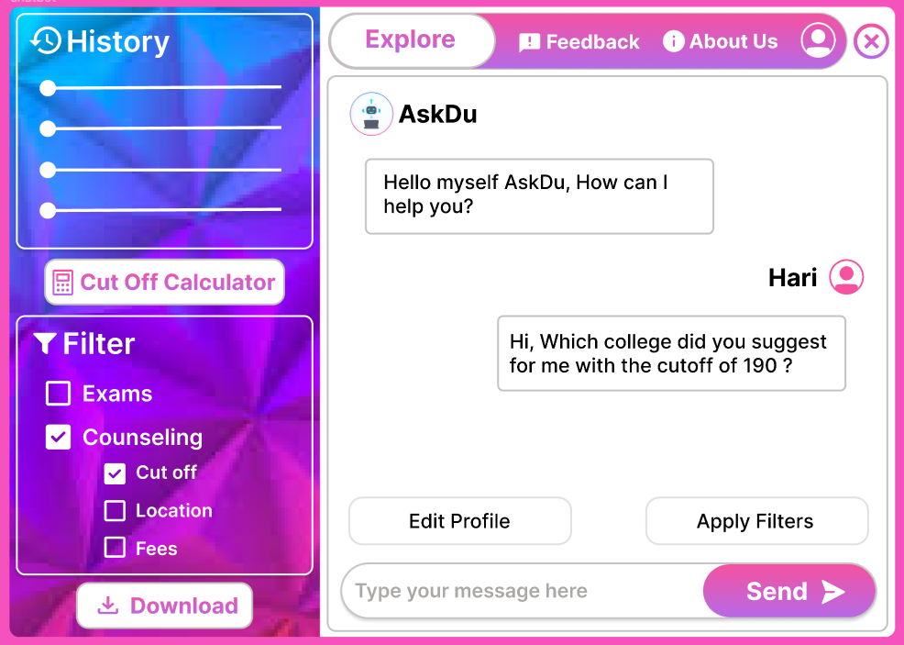
2. MODEL TRAINING & CHATBOT INTERFACE MODULE
This module is responsible for training recommendation models and providing an interface for the chatbot.
It involves preprocessing data, selecting appropriate features, training recommendation algorithms (e.g., content-based, collaborative filtering), and optimizing hyperparameters.
Additionally, it allows users to interact with the recommendation system through natural language queries.

Slide 16
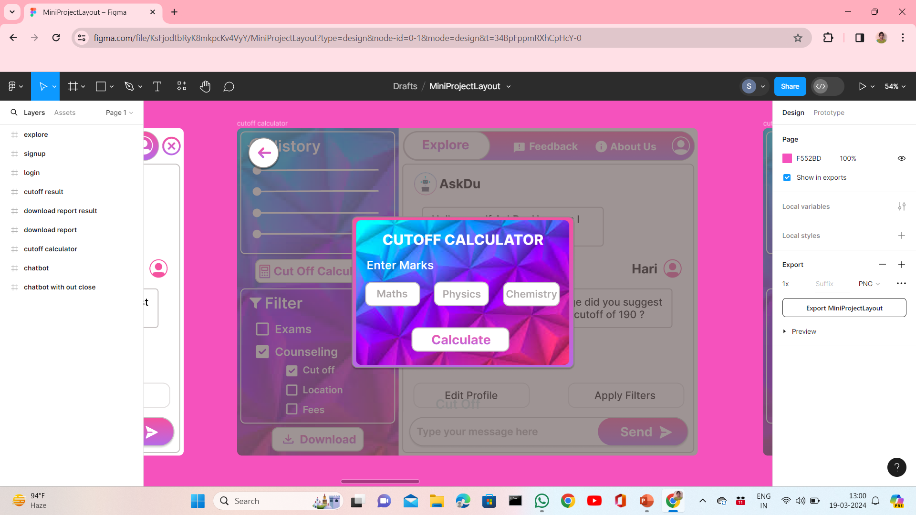
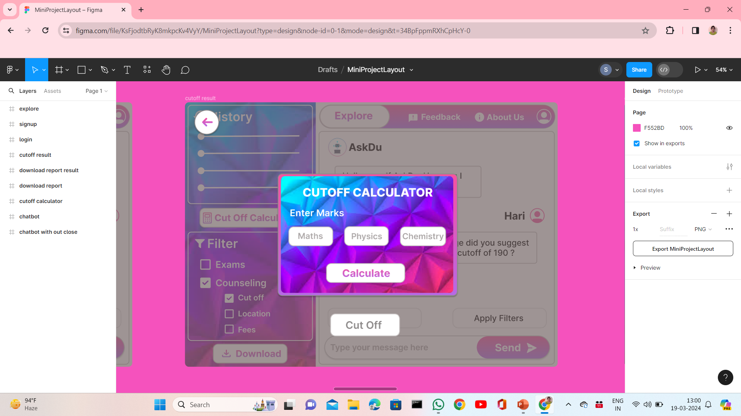
3. CUT OFF CALCULATOR MODULE
Users can input their academic performance and preferences to estimate their eligibility for admission to colleges.
The module dynamically computes cutoff scores based on user-provided marks.
Recommendations are provided to users based on calculated cutoff scores, assisting them in identifying colleges where they are likely to meet admission criteria.

Slide 17
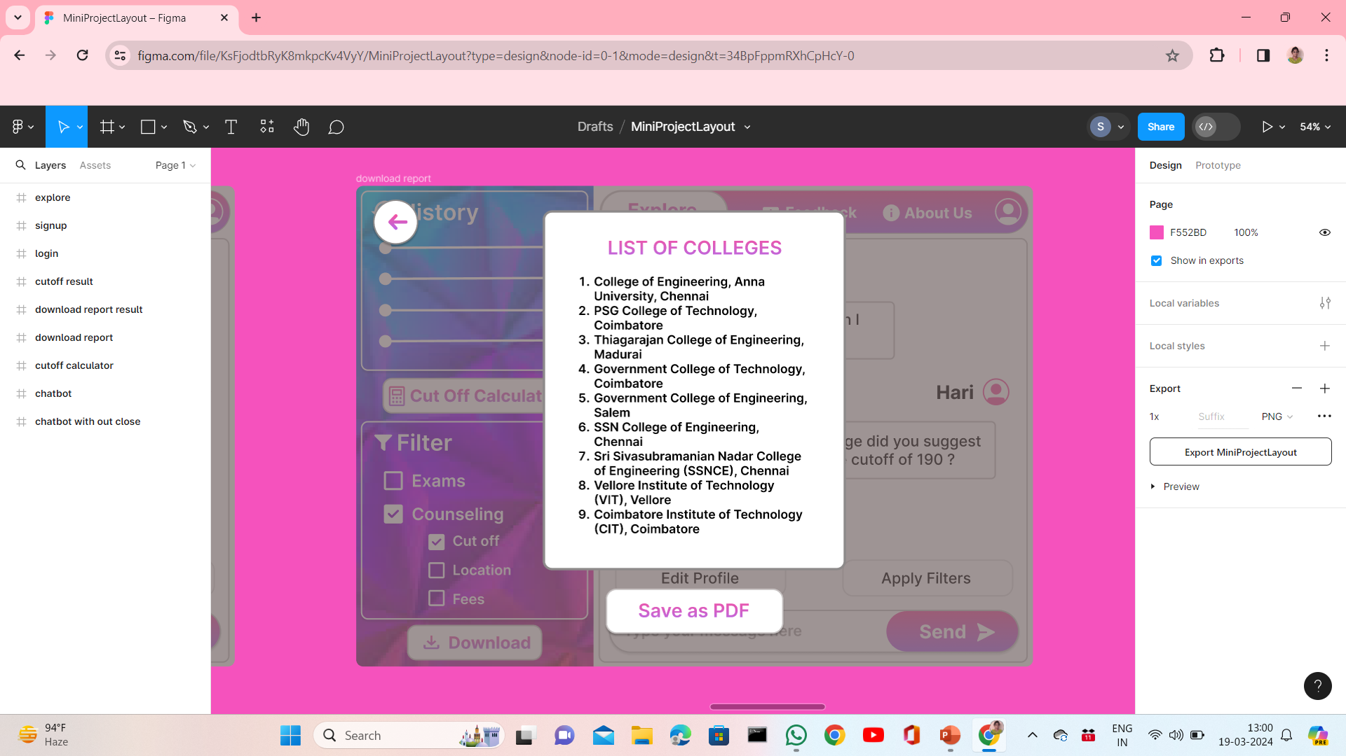
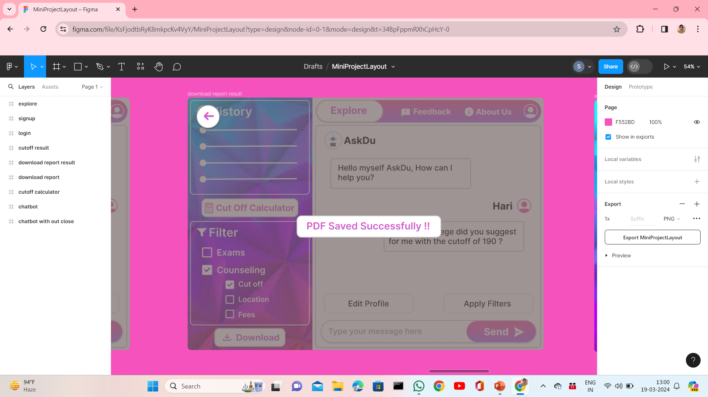
4. REPORT DOWNLOAD MODULE
This module allows users to download reports or summaries of their interactions with the system.
Users can generate and download reports containing information such as recommended colleges, user preferences, chatbot conversations, etc.
It provides users with a way to access and review their activity within the system or share it with others as needed.

Slide 18
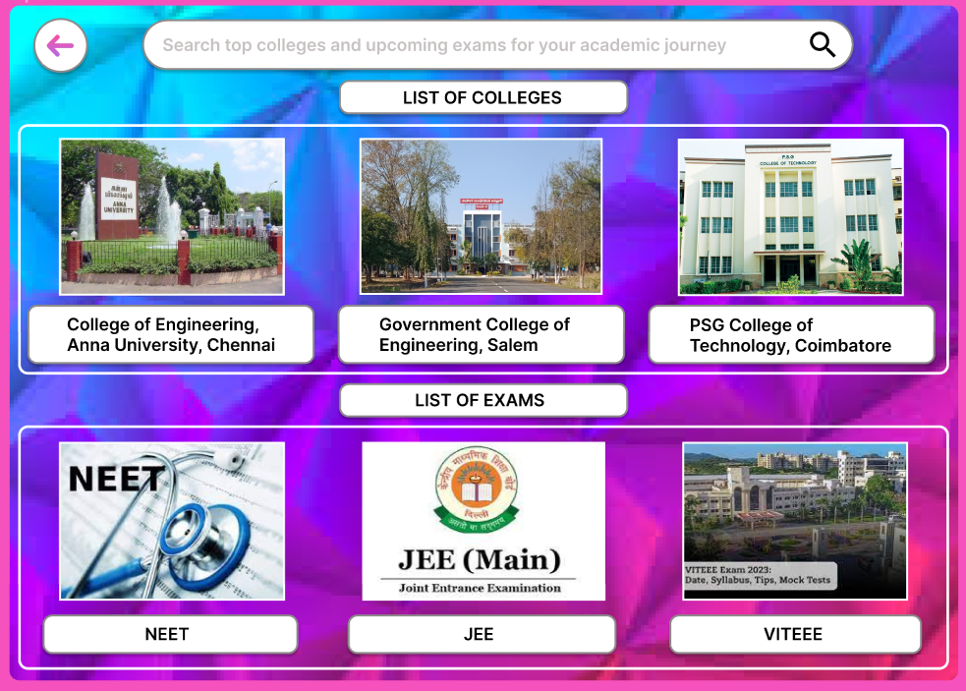
5. EXPLORE MODULE
This module enables users to explore information about colleges, courses, and admission criteria.
It provides features such as browsing college profiles, viewing available courses, checking admission requirements, and accessing additional resources.
Users can also explore about various competitive exams.

Slide 19





ALGORITHM/TECHNIQUE USED
FRONT-END
HTML – Hyper Text Markup Language
CSS – Cascading Style Sheet
JS – JavaScript
Bootstrap – CSS Framework
AI CHATBOT
NLP – Natural Language Processing Libraries
Python – Advanced Libraries
BACK-END
Node – JS Server
MongoDB – Database
Flask – Python Framework

Slide 20
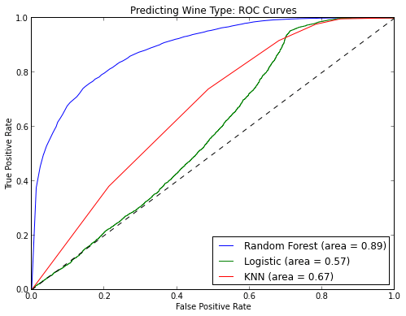
RANDOM FOREST MODEL
Random Forest Classifier is an ensemble learning algorithm that combines multiple decision trees trained on random subsets of the data to make predictions.
It's robust, versatile, and effective for both classification and regression tasks, with built-in mechanisms to reduce overfitting and handle diverse types of data.

Slide 21



STEPS IN BUILDING RANDOM FOREST MODEL
LOAD THE DATASET:
- Load the dataset 'model_dataset.csv' into a pandas DataFrame.
DATA PREPROCESSING:
- Check for missing values and handle them if any.
- Convert categorical variables (college name, college code, course admitted) into
numerical format using techniques like one-hot encoding or label encoding.
SPLIT THE DATASET:
- Split the dataset into features (X) and target variable (y), where X contains the input
features (cutoff scores, college information) and y contains the target variable (course admitted).
- Split the data into training and testing sets using train_test_split function from sklearn.

Slide 22


TRAIN THE RANDOM FOREST CLASSIFIER MODEL:
- Import the RandomForestClassifier class from sklearn.ensemble.
- Instantiate the RandomForestClassifier with desired hyperparameters (e.g., number of
trees, maximum depth).
- Fit the model to the training data using the fit method.
MODEL EVALUATION:
- Predict the classes for the test set using the predict method.
- Evaluate the model's performance using classification metrics such as accuracy,
precision, recall, and F1-score.
- Optionally, visualize the confusion matrix or other relevant metrics to assess the model’s
performance.

Slide 23
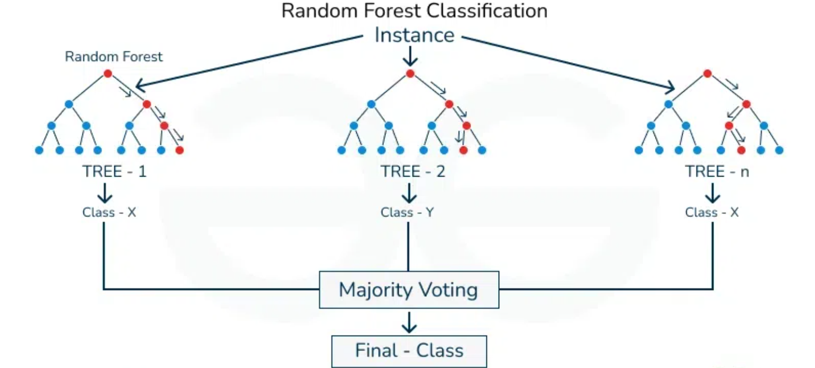
RANDOM FOREST CLASSIFIER ARCHITECTURE

Slide 24

CONCLUSION
The AskDu: Empowering Students with AI-Driven Career Navigation and College Counselling Assistance developed assists students in selecting the right college and course based on their preferences.
Through machine learning algorithms and user-friendly interfaces, it provides personalized recommendations and cutoff score calculations.
Rigorous testing ensures reliability and accuracy.
Continuous improvement will ensure it remains a valuable tool for students navigating their higher education choices.

Slide 25

FUTURE WORK
Enhanced Recommendation Algorithms:
Explore advanced machine learning techniques and algorithms to improve the accuracy and
relevance of recommendations. Consider incorporating deep learning models or hybrid
recommendation approaches for better performance.
2. Integration with Real-Time Data:
Integrate the system with real-time data sources such as college admission portals, student
feedback platforms, and employment databases to provide up-to-date information and insights
for users.
3. Collaboration with Educational Institutions:
Collaborate with colleges, universities, and educational institutions to provide tailored
recommendations and promote partnerships for student enrollment and career placement programs.
4. Global Expansion:
Expand the recommendation system to encompass various streams, colleges, and universities
across India.

Slide 26

REFERENCES
Mopelola, O. & Benjamin B. (2013) “Career Guidance for Nigerian Students: Why Career Choice Is Becoming More Difficult”. Retrieved From, vol. 1, no. 3, pp. 1-16, 2013.
Abisoye, O. A., Alabi, I., Ganiyu, S. O., Abisoye, B. O., and Omokore, J. (2015). “A Web-Based Career Guidance Information System for Pre-Tertiary Institutions Students in Nigeria”. The International Journal of Scientific Research in Science, Engineering and Technology, vol. 87, no. 2, pp. 80-90, Nigeria 2015.
Balogun, V. F., and Thompson, A. F. (2009) “Career Master: A Decision Support System (DSS) for Guidance and Counselling in Nigeria. The Pacific Journal of Science and Technology”, vol. 19, no. 6, pp. 126-148, Nigeria 2009.
Crystal D’Mello “Online Career Guidance System”, In International Journal of Advanced Research in Computer Science and Software. vol 7, no. 8, pp. 83-100, February 2018.
JoAnn Harris-Bowlsbey, Ed.D. Kuder Research Faculty “Overview of Career Guidance: Its Foundations, Objectives, and Methodology”, White Paper, Kuder.2321– 8169 vol. 1, no. 5, pp. 163-176, December 2017.

Slide 27


